Slide 1
ROS
데칼코마니

Slide 2
Jetson nano
Bionic jetpack 4.5.1
Raspberry pi4
8GB - buster
ROS Melodic
ROS_MASTER_URI=https://192.168.0.70:11311
ROS_IP : 192.168.0.70
ROS_MASTER_URI=https://192.168.0.70:11311
ROS_IP : 192.168.0.88
① Publish
CAM Node
Action : Hand tracking & Motion detection
Packages : Opencv (4.5.5V) , Mediapipe (0.8.5V)
Wi-Fi
③ subscribe
Hand_control Node
/hand_position
Robot hand controller
② Publish
Servo/PWM
Pi HAT
STT Node
Action : 의미분석,언어생성 및 음성합성(TTS)
Packages : Playsound, gtts, Speech_recognition
/sound
Robot hand

Slide 3
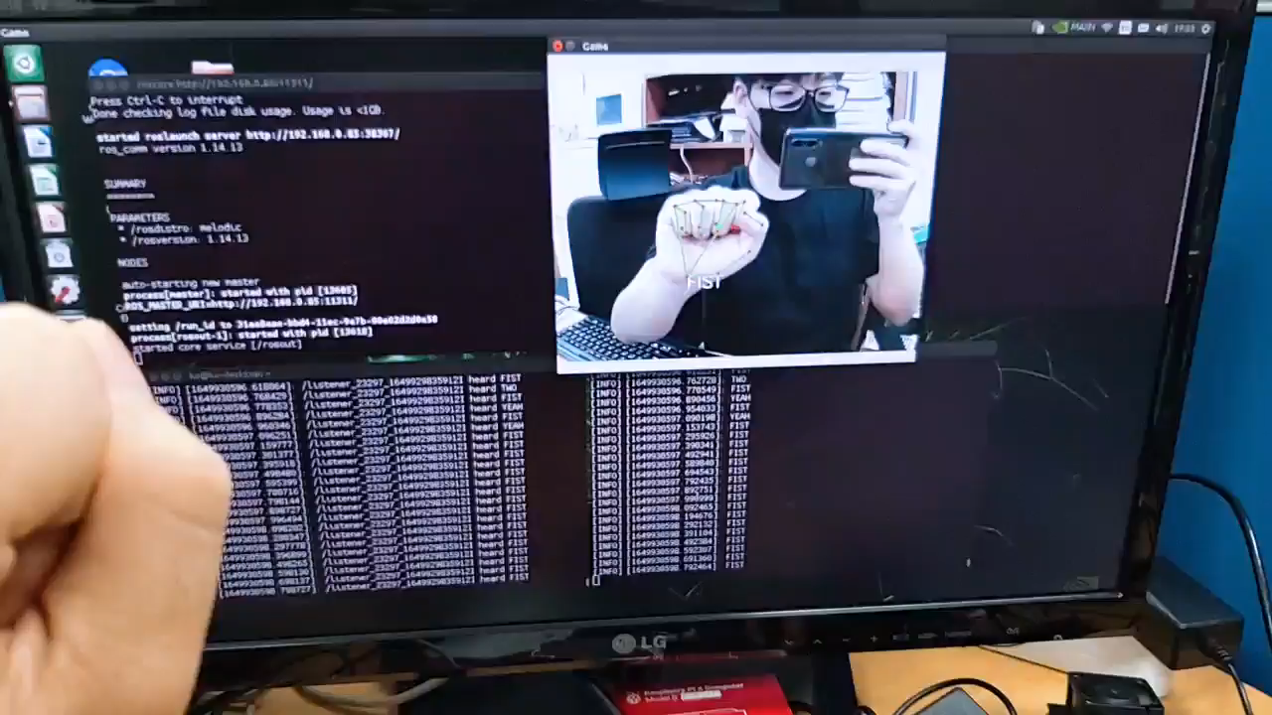
ROS

